Slide 1
Steering Behaviors Graphs
GAM 376

Slide 2
Outline
Steering Behaviors
Theory
Implementations
Graphs

Slide 3
Question
How to get agents to move around in game worlds?
Leads to an AI question
How do humans (and other creatures) move around in their world?

Slide 4
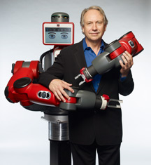
Subsumption Architecture
How to implement robot navigation?
first attempts were very, very slow
robot had to totally understand its world before moving
world changed while it moved
Rod Brooks changed the game
parallel decision making
different concerns at different levels
results unified later
there is some evidence that the brain works like this
Kahneman, “Thinking Fast and Slow”

Slide 5
Subsumption Architecture II
Brooks' levels
reactive
quick, instinctive
stop when you get to the door
executive
automatic, sequential
stick out your hand, turn knob, push door
deliberative
requires thought
if knob doesn't turn, look for key
if door doesn't push, try pulling

Slide 6
Subsumption Architecture III
Very useful for thinking about game agents
deliberative
goal-driven behavior
executive
finite state machine
reactive
scripts
steering behaviors
Often agents are not too smart
animals, monsters
deliberative behavior not expected
good reactive behaviors go a long way

Slide 7
Today
We will start talking about navigation
reactive
steering behaviors
deliberative
groundwork via graphs

Slide 8
Examples
I want the insect monsters to swarm at the player all at once,
but not get in each other's way.
I want the homing missile to track the ship and close in on it.
I want the guards to wander around,
but not get too far from the treasure and not too close to each other.
I want pedestrians to cross the street,
but avoid on-coming cars.

Slide 9
Steering behavior solution
Write a mathematical rule
that describes accelerations to be made
in response to the state of the environment
Example: "don't hit the wall"
generate a backwards force inversely proportional to the proximity of the wall
the closer you get, the more you will be pushed away
if you're going really fast, you'll get closer to the wall, but you'll slow down smoothly

Slide 10
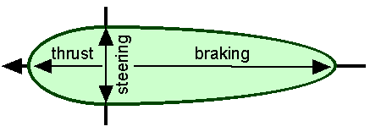
Steering forces
Acceleration is caused by forces
so we call these effects steering forces
Forces are multiple and asymmetrical
you can stop faster than you can accelerate
it is hard to turn on a dime

Slide 11
Combining forces
Behaviors can be combined by
summing the forces that they produce
Example: follow
I want the spy to follow the general, but not too close
two behaviors
go to general's location
creates a force pointing in his direction
not too close
a counter-force inverse proportion to distance
where the forces balance
is where spy will tend to stay

Slide 12
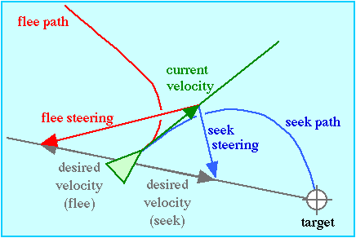
Seek / Flee I
animation

Slide 13
Seek / Flee II
The desired velocity is towards the target
Calculate the steering force needed to turn the current velocity into that one
P_{target} – P_{current} = H_{target}
V_{desired}=Norm(H_{target})*V_{max}
F_{steer}=V_{desired}-V_{current}
Flee just takes the opposite heading

Slide 14
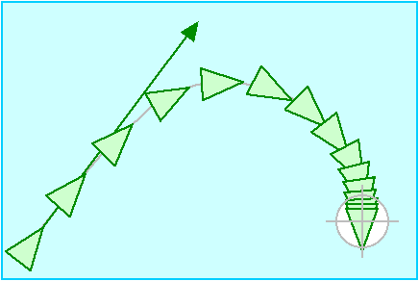
Arrive I
Seek can overshoot
it arrives at the target at Vmax
Arrive aims to decelerate as it approaches
animation

Slide 15
Arrive II
Do the same calculation as seek
but V_{desired} is now a function of the distance
V_{desired}=(||H_{target}||/K)*Norm(H_{target})*V_{max}
when H_{target} < K
full speed far away, slower closer

Slide 16
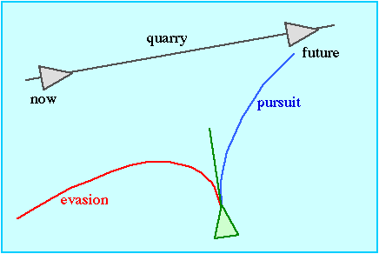
Pursue / Evade I
Suppose I want to after a moving thing
rather than a fixed point
if I steer to current location
it will be gone
animation

Slide 17
Evade
Similarly
It may not be effective to run away from attacker’s current position
X

Slide 18
Pursue / Evade II
The same as Seek, but now the position of the target is estimated into the future
P'_{target} = P_{target} + V_{target} * T_{toTarget}
This is "smarter" behavior
aims to "cut off" the quarry
Similarly for Evade
flee the target's future position
How to calculate time to target?
hard to do this precisely
estimate with time to target's current position
T_{toTarget}=P_{target} / V_{max}
If you want to get fancy
you can include turning time

Slide 19
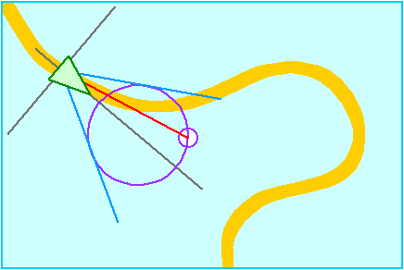
Wander I
We may want our agent to move randomly about
selecting random heading and velocity looks jerky and unnatural
What we want is random motion that has a certain smoothness
animation

Slide 20
Wander II
Solution is to put a circle in front of the agent
pick a point on the circle
head towards it
move the point randomly
Parameters
Circle size
Small circle means heading will vary less
Jitter
Larger means that the target point can move farther on the circle
Wander distance
The farther the circle is ahead of the agent, the greater the steering force associated with it

Slide 21
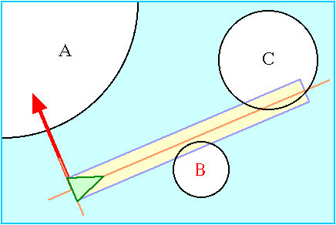
Obstacle avoidance I
We always want our agents to avoid obstacles
avoids stupidity
animation

Slide 22
Obstacle avoidance II
Basic idea
project a box forward in the direction of motion
think of the box as a "corridor of safety"
as long as there are no obstacles in the box
motion forward is safe
To do this
find all of the objects that are nearby
too expensive to check everything
ignore those that are behind you
see if any of the obstacles overlap the box
if none, charge ahead
if several, find the closest one
this is what we have to avoid

Slide 23
Obstacle avoidance III
Steering force
we want to turn away from the obstacle
just enough to miss it
we want to slow down
so we have time to correct
Need a steering force perpendicular to the agent's heading
proportional to how far the obstacle protrudes into the detection box
Need a braking force anti-parallel to agent's heading
proportional to our proximity to obstacle

Slide 24
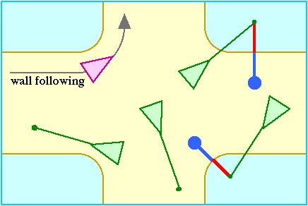
Wall avoidance I
Seems like a special case of obstacle avoidance but it isn't
a wall is a very large obstacle
calculations involving its radius aren't very useful
animation

Slide 25
Wall avoidance II
Project lines in front of the agent
whiskers
If the whiskers touch a wall
create a steering force proportional to the degree of penetration into the wall
Reynold's uses a slightly different technique
use a single whisker but move it around

Slide 26
Hide
Position a hiding agent so it is behind an obstacle
relative to another seeker agent
For each obstacle
project a line from the seeker through all obstacles
hiding positions are on the other side
find the closest one and arrive to it
Demo

Slide 27
Hide II
Lots of tweaks possible
avoid hiding positions in front of seeker
Avoid "magic" hiding
always knowing where the seeker is

Slide 28
Path Following
It is easy to have an agent follow a path
but it doesn't always look natural
Simple implementation
seek from point to point
works if paths are line segments
More complex
create a tunnel around path and do wall following

Slide 29
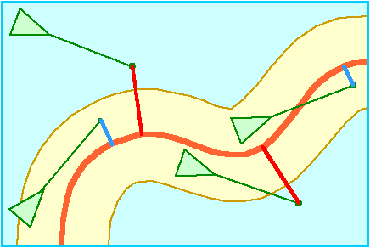
Path Following II
animation
demo

Slide 30
Offset Pursuit
Follow another agent at some position
synchronized swimming, anyone?
Calculate an offset behind the leader
Try to Arrive at this point
demo

Slide 31
Group behaviors
Behaviors that depend on a neighborhood of other agents
Classic examples
fish schooling
birds flocking

Slide 32
Separation
"Don't crowd"
Basic idea
generate a force based on the proximity of each other agent
sum all of the vectors
Result
Each agent will move in the distance that takes it furthest from others
Neighbors disperse from each other

Slide 33
Alignment
"Stay in step"
Basic idea
keep an agent's heading aligned with its neighbors
calculate the average heading and go that way
Result
the group moves in the same direction

Slide 34
Cohesion
"Stay together"
Basic idea
opposite of separation
generate a force towards the center of mass of neighbors
Result
group stays together

Slide 35
Combining these behaviors
We get flocking
different weights and parameters yield different effects
Buckland demo

Slide 36
Implementation issues
Combining behaviors
each steering behavior outputs a force
it is possible for the total force to exceed what an agent's acceleration capacity
Efficiency
flocking requires calculating forces from all other agents
Jitter
frequent sudden shifts of heading

Slide 37
Combination methods
Simplest: Weighted truncated sum,
weight the behaviors, add up, and truncate at max_force
very tricky to get the weights right
must do all of the calculations
Better: Prioritization
Evaluate behaviors in a predefined order
obstacle avoidance first
wander last
Keep evaluating and adding until max_force reached
Problem is getting the fixed priority right
Cheaper: Prioritized dithering
Associate a probability with each behavior
probabilities sum to 1
That behavior will get its force applied a certain percentage of the time

Slide 38
Demos

Slide 39
Partitioning
We want to calculate the neighbors of each agent
if we look at all agents, n² operation
if there are many, many agents, too slow
Many techniques for speeding this up
basic idea is to consider only those agents that could be neighbors
carve up space and just look at the relevant bits
Very important in other parts of game programming, too
collision detection
view rendering

Slide 40
Cell-space partition
Cover space with a grid
Maintain a list of agents in each cell
not that expensive since it is just an x,y threshold test
Calculate which grid cells could contain neighbors
check only those agents in the effected cells
O(n)

Slide 41
Smoothing
Jitter occurs when behaviors switch in and out
obstacle avoidance kicks in when objects is in detection box
but other behaviors push back towards obstacle
Solution
average the heading over several updates

Slide 42
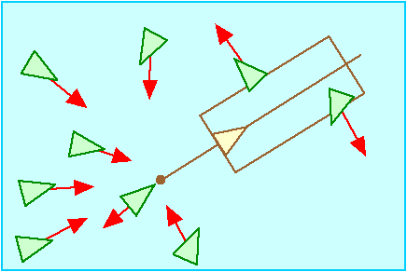
Leader following
Important hint: think about this calculation in the leader’s coordinate system

Slide 43
Existing code
Offset Pursuit implementation
Game world setup

Slide 44
Break
After break, graphs
some review from your data structures class
some new material

Slide 45
Navigation part II
What if I want to get somewhere in particular?
location of power-up
If it is close
steering behaviors are fine
If it isn’t
steering behaviors are terrible
Need something deliberative
path planning
based on graphs

Slide 46
Graph Algorithms
Very important for real world problems:
Class prerequisites can be represented as a graph. What is a valid course order?
Traffic flow can be modeled with a graph. What are the shortest routes?
Traveling Salesman Problem: What is the best order to visit a list of cities in a graph?
LinkedIn is a graph of people. Who should we recommend you connect to next?

Slide 47
Graph Algorithms in Games
Many problems reduce to graphs
path finding
tech trees in strategy games
state space search
problem solving
"game trees"

Slide 48
What is a Graph?
A graph G = (V,E) consists of a set of vertices V and a set of edges E. Each edge is a pair (v,w) where v and w are vertices.
If the edges are ordered (indicated with arrows in a picture of a graph), the graph is “directed” and (v,w) != (w,v).
Edges can also have weights associated with them.
Vertex w is “adjacent” to v if and only if (v,w) is an edge in E.

Slide 49
An Example Graph
v1
v2
v4
v5
v3
v6
v7
v1, v2, v3, v4, v5, v6, and v7 are vertices. (v1,v2) is an edge in the
graph and thus v2 is adjacent to v1. The graph is directed.

Slide 50
Definitions
A “path” is a sequence of vertices w₁, w₂, w₃, …, w_{n} such that (w_{i}, w_{i+1}) are edges in the graph.
The “length” of the path is the number of edges (n-1).
A “simple” path is one where all vertices are distinct, except perhaps the first and last.

Slide 51
An Example Graph
v1
v2
v4
v5
v3
v6
v7
The sequence v1, v2, v5, v4, v3, v6 is a path. The length is 5.
It is a simple path.

Slide 52
Graph search
Problem
is there a path from v to w?
what is the shortest / best path?
optimality
what is a plausible path that I can compute quickly?
bounded rationality

Slide 53
General search algorithm
Start with
"frontier" = { (v,v) }
Until frontier is empty
remove an edge (n,m) from the frontier set
mark n as parent of m
mark m as visited
if m = w,
return
otherwise
for each edge <i,j> from m
add (i, j) to the frontier
if j not previously visited

Slide 54
Note
We don't say how to pick a node to "expand"
We don't find the best path, some path

Slide 55
Depth First Search
Last-in first-out
We continue expanding the most recent edge until we run out of edges
no edges out or
all edges point to visited nodes
Then we "backtrack" to the next edge and keep going

Slide 56
DFS
v1
v2
start
v4
v5
v3
v6
v7
target

Slide 57
Characteristics
Can easily get side-tracked into non-optimal paths
Very sensitive to the order in which edges are added
Guaranteed to find a path if one exists
Low memory costs
only have to keep track of current path
nodes fully explored can be discarded
Typical Complexity
Time: O(E/2)
Space: O(log n)
assuming paths are short relative to the size of the graph
often paths will be shorter

Slide 58
Optimality
DFS does not find the shortest path
returns the first path it encounters
If we want the shortest path
we have to keep going
until we have expanded everything
Complexity
O(E)

Slide 60
Iterative Deepening DFS
Add a parameter k
Only search for path of lengths <= k
Start with k = 1
while solution not found
do DFS to depth k
Sounds wasteful
searches repeated over and over
but actually not too bad
more nodes on the frontier
finds optimal path
less memory than BFS

Slide 61
Breadth-first search
First-in first-out
Expand nodes in the order in which they are added
don't expand "two steps" away
until you've expanded all of the "one step" nodes

Slide 62
BFS
v1
v2
start
v4
v5
v3
v6
v7
target

Slide 63
Characteristics
Will find shortest path
Won't get lost in deep trees
Can be memory-intensive
frontier can become very large
especially if branching factor is high
Typical Complexity
Time: O(b log n)
b = branching factor
Space: O(n)

Slide 64
Buckland implementations

Slide 65
Exercise
1
Nodes | Edges
1 | 1-4, 1-3, 1-2
2
3 | 3-4, 3-5
4 | 4-6
5 | 5-2, 5-6
6 | 6-3
2
3
4
5
6
Path from node1 to node6
depth-first
breadth-first

Slide 66
What if edges have weight?
If edges have weight
then we might want the lowest weight path
a path with more nodes might have lower weight
Example
a path around the lava pit has more steps
the path through the lava pit is shorter
but you will lose health going through the pit
there is a “cost” to some nodes or edges

Slide 67
Weighted graph
1
v1
v2
1
1
5
3
1
v5
v3
v4
3
3
2
2
1
v6
v7
3

Slide 68
Edge relaxation
It is not enough to know
node n is reachable via path P
We need to know the cost to reach node n via path P
because path Q might be cheaper
In which case
we discard path P
it can't enter into a solution
Must store
best path to n and score of path

Slide 69
Djikstra's Algorithm
Use a priority queue
a data structure in which the item with the smallest "value" is always first
items can be added in any order
Use the "value" of an edge as the total cost of the path through that edge
always expand the node with the least cost so far
If an edge leads to a previously expanded node
compare costs
if greater, ignore edge
if lesser, replace path and estimate at node with new value
"Greedy" algorithm

Slide 70
Djikstra's algorithm
Queue:
1
v1
v2
1
1
5
3
3
1
1
4
v4
v5
v3
3
4
5
3
5
3
2
2
1
6
6
v6
v7
3

Slide 71
Characteristics
We have discovered
the cheapest route from start
to every node
nice side effect
Can be deceived by early gains
garden-path phenomenon
Guaranteed to find the shortest path
Complexity
O(|E| log |E|)
not too bad

Slide 72
Priority Queue
This algorithm depends totally on the priority queue
Various techniques to implement
sorted list
yuck
heap
better
many proposed variants

Slide 73
Problem
This algorithm only uses “sunk cost”
the expense of the path so far
Suppose we know that some paths are likely to get us closer?
can’t use this information

Slide 74
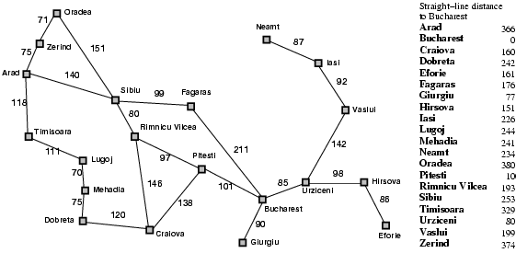
Different Example
Problem: Visit too many nodes, some clearly out of the question

Slide 75
Better Solution: Heuristic
Use heuristics to guide the search
Heuristic: estimation or “hunch” of how to search for a solution
We define a heuristic function:
h(n) = “estimate of the cost of the cheapest path from the starting node to the goal node"
We could use this instead of our greedy "lowest cost so far" technique

Slide 76
Use a Heuristic for cost
Heuristic: minimize h(n) = “Euclidean distance to destination”
Problem: not optimal (through Rimnicu Vilcea and Pitesti is shorter)

Slide 77
The A* Search
Difficulty: we want to still be able to generate the path with minimum cost
A* is an algorithm that:
Uses heuristic to guide search
While ensuring that it will compute a path with minimum cost
“estimated cost”
A* computes the function f(n) = g(n) + h(n)
“actual cost”

Slide 78
A*
f(n) is the priority (controls which node to expand)
f(n) = g(n) + h(n)
g(n) = “cost from the starting node to reach n”
h(n) = “estimate of the cost of the cheapest path from n to the goal node”
h(n)
20
g(n)
15
n
10
5
15
18
20
25
33

Slide 79
Example
A*: minimize f(n) = g(n) + h(n)

Slide 80
Properties of A*
A* generates an optimal solution if h(n) is an admissible heuristic and the search space is a tree:
h(n) is admissible if it never overestimates the cost to reach the destination node
A* generates an optimal solution if h(n) is a consistent heuristic and the search space is a graph:
h(n) is consistent if for every node n and for every successor node n’ of n:
h(n) ≤ c(n,n’) + h(n’)
“triangle inequality”
h(n)
n
d
c(n,n’)
h(n’)
n’

Slide 81
Admissible Heuristics
A heuristic is admissible if it is too optimistic, estimating the cost to be smaller than it actually is.
Example:
for maps
Euclidean distance
no path can be shorter than this
but this requires a square root
for grid maps
Manhattan distance is sometimes used

Slide 82
Inadmissable Heuristics
If a heuristic sometimes overestimates the cost of a path
then A* is not guaranteed to be optimal
it might miss paths that are valid
On the other hand
a stronger (higher-valued) heuristic is better
it focuses the search more
(Djikstra is just A* with h(n) = 0 for all n)
Some path planners use inadmissable heuristics on purpose
if benefits of quicker planning are worth more than the cost of the occasional missed opportunity

Slide 83
Buckland implementation

Slide 84
Summary
Graphs are very common for representing paths in games
Finding a route from one place to another in a game
is often a problem of graph search
For special cases of graph seach
especially spatial ones
we can use A* heuristic search
We covered this VERY FAST
we’ll return to it again in Week 8

